Slide 1
Thevenin's and Maximum Power Transfer Theorem
Module 1: Fundamentals of DC Circuits
EEE1024 Fundamentals of Electrical and Electronics Engineering

Slide 2

module 1
Current & Charge
Voltage, Power & Energy – Power Triangle
Ohm’s Law – Ohm’s Law Triangle & Pie Chart
KCL
Node
KCL Law
Series Elements
KVL
Loop
KVL Law
Parallel Elements
Equivalent Resistances of Series and Parallel Resistances
Node-Voltage Analysis
Mesh-Current Analysis
Thevenin’s Theorem
Maximum Power Transfer

Slide 3
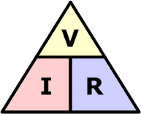
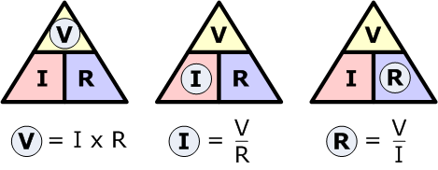

Ohms Law Triangle

Slide 4
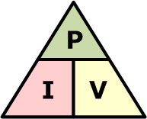
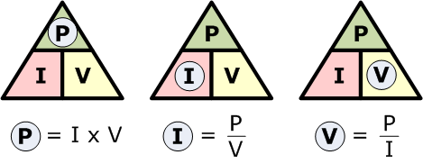
Power Triangle

Slide 5
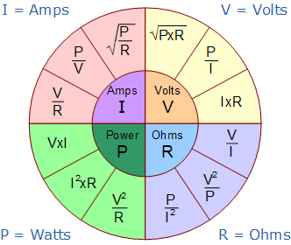
Ohms Law Pie Chart

Slide 6
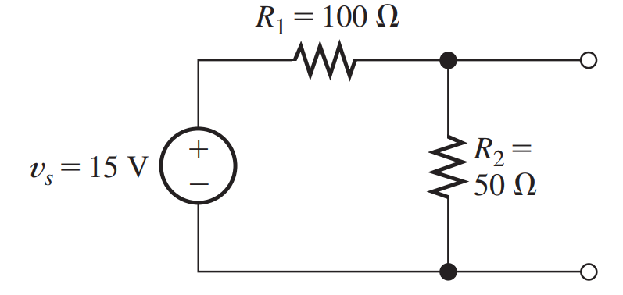
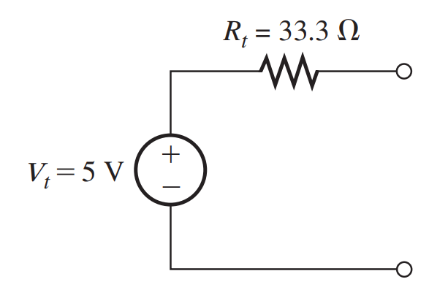

Thevenin’s theorem
Here, we learn how to replace two-terminal circuits containing resistances and sources by simple equivalent circuits.
By a two-terminal circuit, we mean that the original circuit has only two points that can be connected to other circuits.

Slide 7
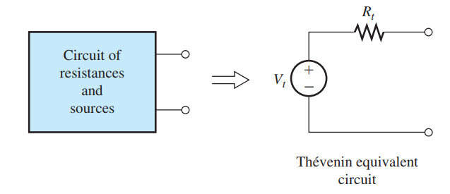
Thevenin Equivalent Circuit
One type of equivalent circuit is the Thevenin equivalent, which consists of an independent voltage source in series with a resistance
Vt is Thevenin’s Voltage
Rt is Thevenin’s Resistance

Slide 8
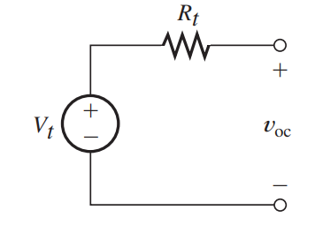
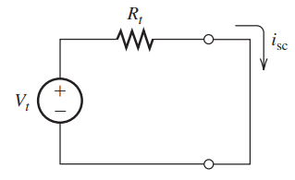

Thevenin Equivalent Circuit
According to the Theorem, the Thevenin source voltage Vt is equal to the open-circuit voltage of the original network.
$$V_{t}=v_{oc}$$
Furthermore, the current flowing in this circuit is
$$i_{sc}=\frac{V_{t}}{R_{t}}$$
$$R_{t}=\frac{V_{t}}{i_{sc}}$$

Slide 9
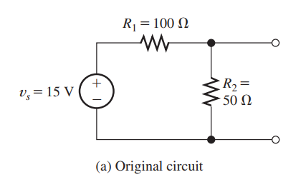
Ex 1: Determining the Thevenin Equivalent Circuit

Slide 10
Finding the ThEvenin Resistance Directly
There is an alternative way to find the Thévenin resistance.
First, we zero the sources in the network.
In zeroing a voltage source, we reduce its voltage to zero. A voltage source with zero voltage is equivalent to a short circuit.
In zeroing a current source, we reduce its current to zero. By definition, an element that always carries zero current is an open circuit.
Thus, to zero the sources, we replace voltage sources with short circuits and replace current sources with open circuits.

Slide 11
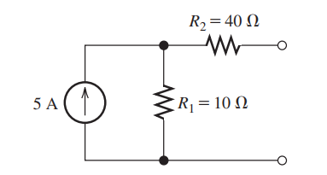
Ex 2: Finding the ThEvenin Resistance Directly

Slide 12
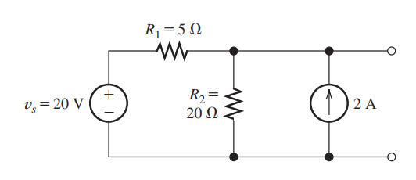
Ex 3: Finding the ThEvenin Resistance Directly

Slide 13
Ex 4: Finding the ThEvenin Equivalent Circuit

Slide 14
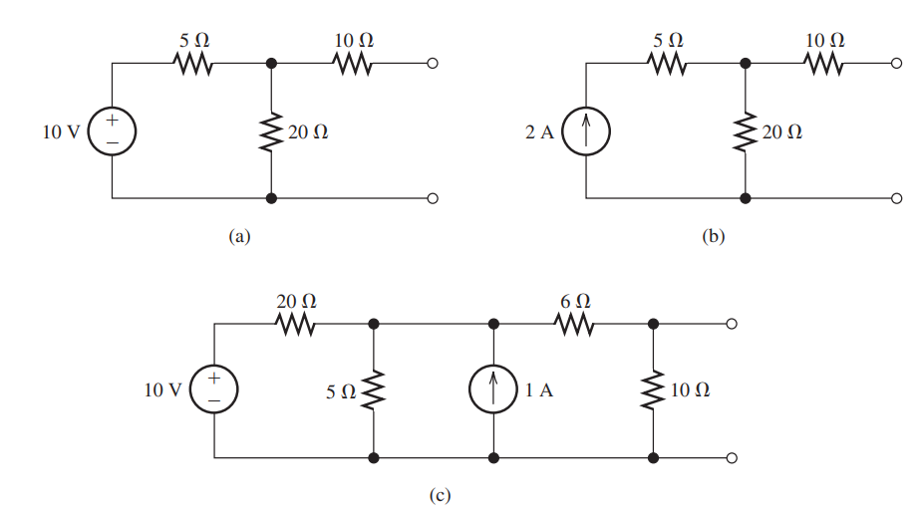
Ex 5: Finding the ThEvenin Resistance Directly
Find the Thévenin resistance for each of the circuits shown in Figure by zeroing the sources.

Slide 15
Maximum Power Transfer

Slide 16
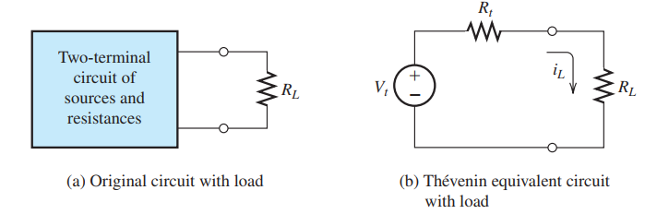
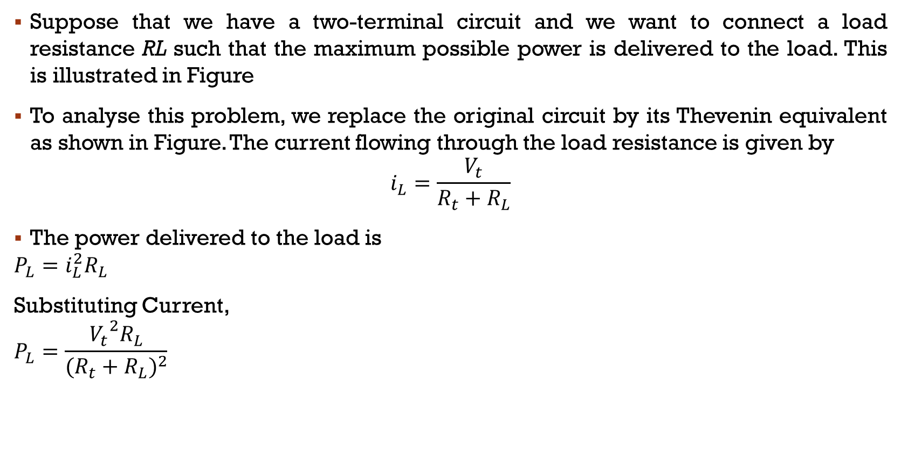
Suppose that we have a two-terminal circuit and we want to connect a load resistance RL such that the maximum possible power is delivered to the load. This is illustrated in Figure
To analyse this problem, we replace the original circuit by its Thevenin equivalent as shown in Figure. The current flowing through the load resistance is given by
$$i_{L}=\frac{V_{t}}{R_{t}+R_{L}}$$
The power delivered to the load is
$$P_{L}=i_{L}^{2}R_{L}$$
Substituting Current,
$$P_{L}=\frac{{V_{t}}^{2}R_{L}}{{(R_{t}+R_{L})}^{2}}$$

Slide 17
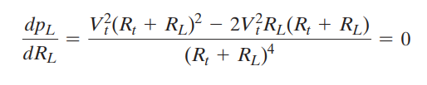
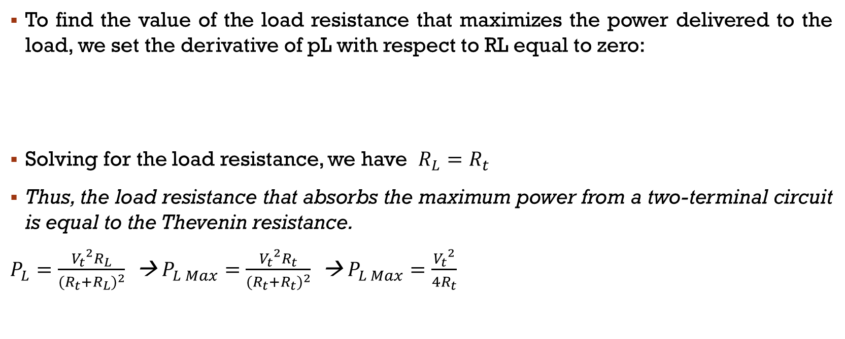
Maximum Power Transfer
To find the value of the load resistance that maximizes the power delivered to the load, we set the derivative of pL with respect to RL equal to zero:
Solving for the load resistance, we have $R_{L}=R_{t}$
Thus, the load resistance that absorbs the maximum power from a two-terminal circuit is equal to the Thevenin resistance.
$P_{L}=\frac{{V_{t}}^{2}R_{L}}{{(R_{t}+R_{L})}^{2}}$ → $P_{L Max}=\frac{{V_{t}}^{2}R_{t}}{{(R_{t}+R_{t})}^{2}}$ → $P_{L Max}=\frac{{V_{t}}^{2}}{4R_{t}}$

Slide 18
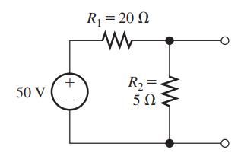
Ex 6: Determining Maximum Power Transfer
Find the load resistance for maximum power transfer from the circuit shown in Figure. Also, find the maximum power.

